Slide 1
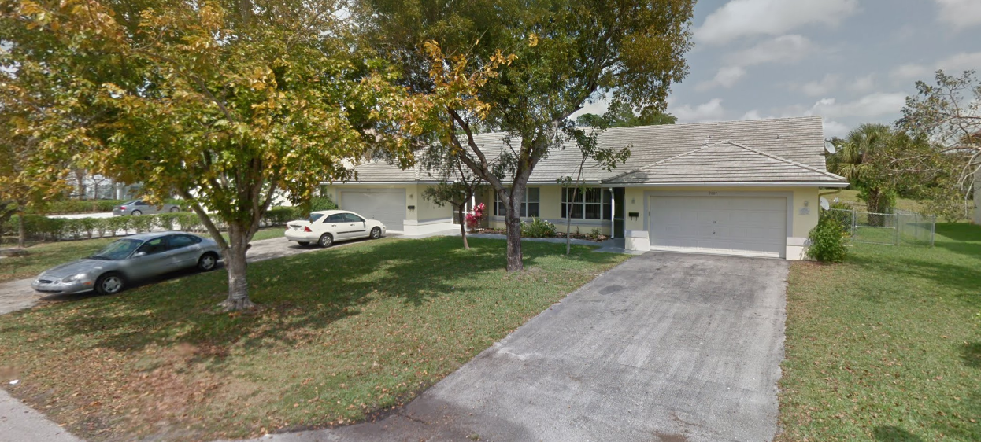

9007-9009 NW 38th Drive
Coral Springs, FL 33065
$460,000 – Closing March 2018
Turn-key Duplex in the heart of Coral Springs
2 – 3 Bedroom/2 Bathroom home with private 2 car garages
Private Pool
Fenced-in Yard
Waterfront
Purchased at $137 per square foot
Coral Springs, Florida was ranked as 27th best city in the US by Money Magazine
Property is in “A” rated school zones
10th Safest city in the USA
Property Income Investors
7301 Wiles Road
Suite 108
Coral Springs, FL 33067

Slide 3
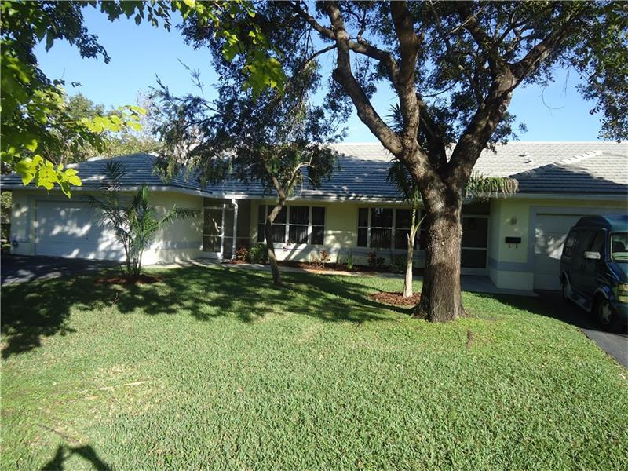
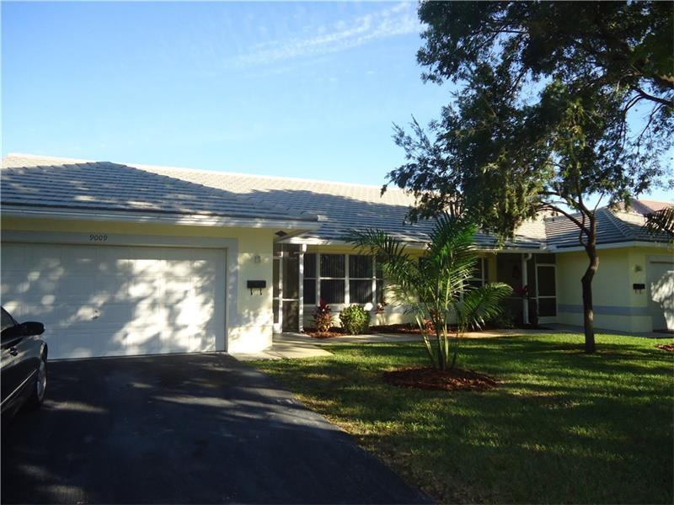
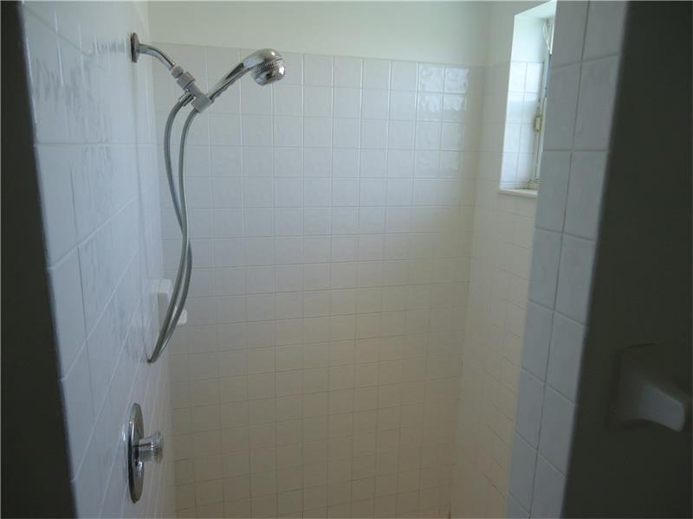
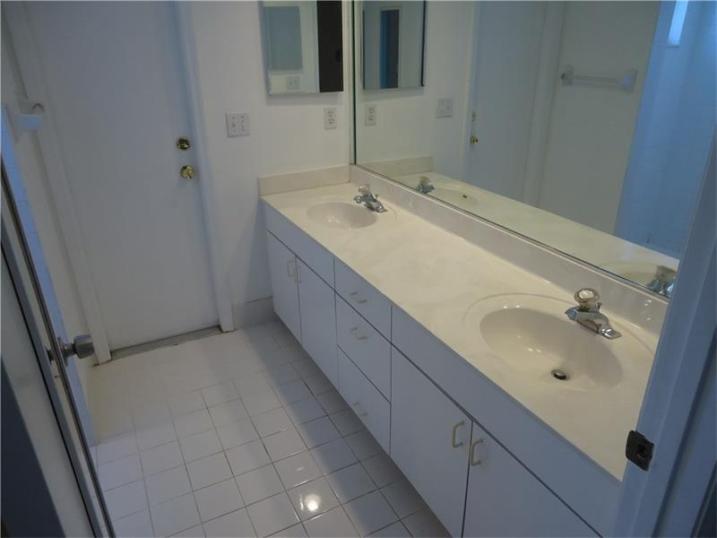
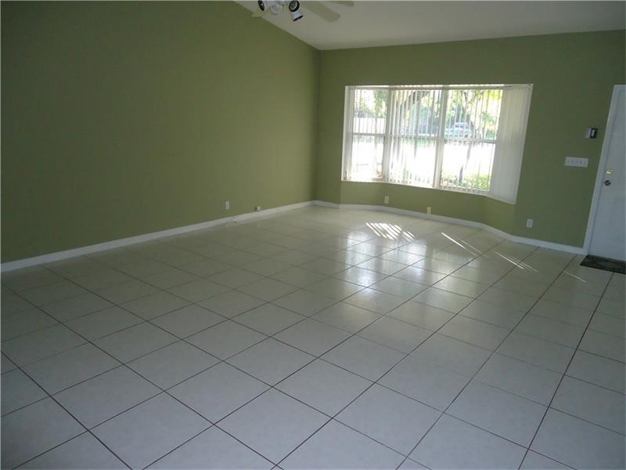
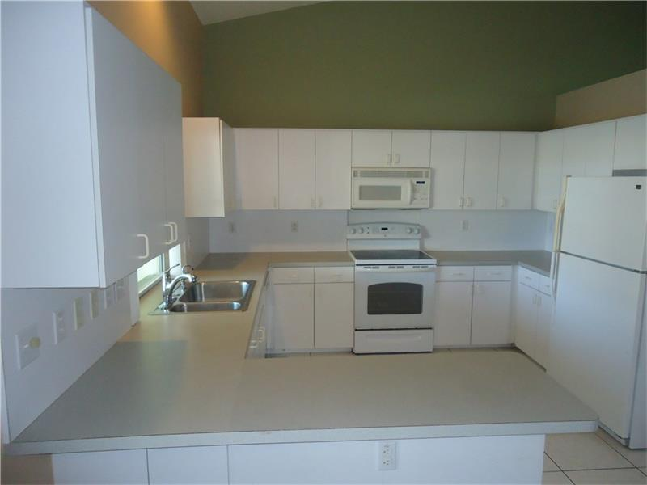
Units are in great condition, exterior and interior
Large, spacious open areas

Slide 4
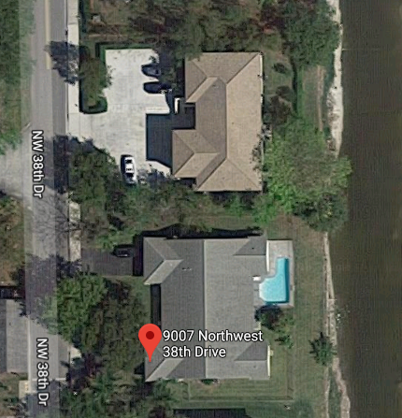
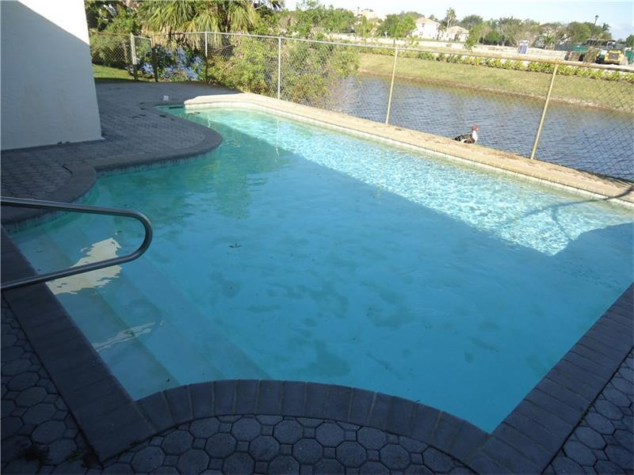
The pool is for exclusive use of one half of the duplex. The other unit has a fence with a large, private yard.

Slide 5

Coral Springs was ranked as the 27th best city in the United States in which to live by Money Magazine in 2006; was named the 10th safest city in the US by Morgan Quitno in 2007; and was a multiple recipient of America's Promise "100 Best Cities for Young People" award, identified by the group as a three-time winner in 2008.
In 2007, Coral Springs became the first state or local government in the nation to receive the Malcolm Baldrige National Quality Award.
In 2010, CNNMoney.com listed Coral Springs as the 44th best place to live in the United States
Property Income Investors
7301 Wiles Road
Suite 108
Coral Springs, FL 33067

Slide 6
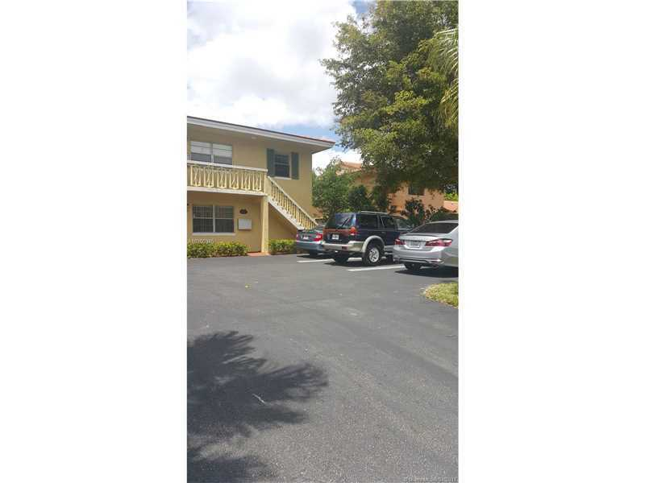
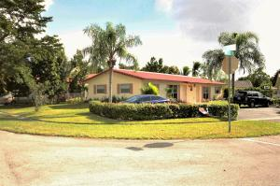
Comparable Properties
4360 Riverside Drive, Coral Springs, FL 33065
Built in 1972
Only 2 Tenants in place at time of purchase
Only on the market for 13 days before selling
Comparable Property
This property was purchased in August 2017 at $540,000. It is a Quadplex on the same street as our property under contract. It was purchased at $172/square foot.
11191 NW 35th Place, Coral Springs, FL 33065
Comparable Property
Built in 1980
Only on the market for 23 days before selling
This property was purchased in 2017 at $280,000. It is a duplex , as is our property under contract. It was purchased at $163/square foot.
Property Income Investors
7301 Wiles Road
Suite 108
Coral Springs, FL 33067

Slide 7
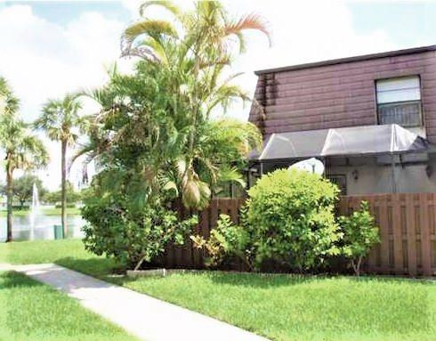
Comparable Properties
Built in 1985
Only on the market for 2 days before selling $5,100 over asking price
Comparable Property
2593 NW 99th Avenue, Coral Springs, FL 33065
This property was purchased in August 2017 at $195,000 in only 2 days on the market, $5,100 over asking price. It was purchased at $169 per square foot.
Property Income Investors
7301 Wiles Road
Suite 108
Coral Springs, FL 33067

